Slide 1
Legal Aid Services Young PWID in Repressive Environment
Alfiana Qisthi
Legal Advocacy Officer
Persaudaraan Korban Napza Indonesia/ Indonesia Drug User Network

Slide 2
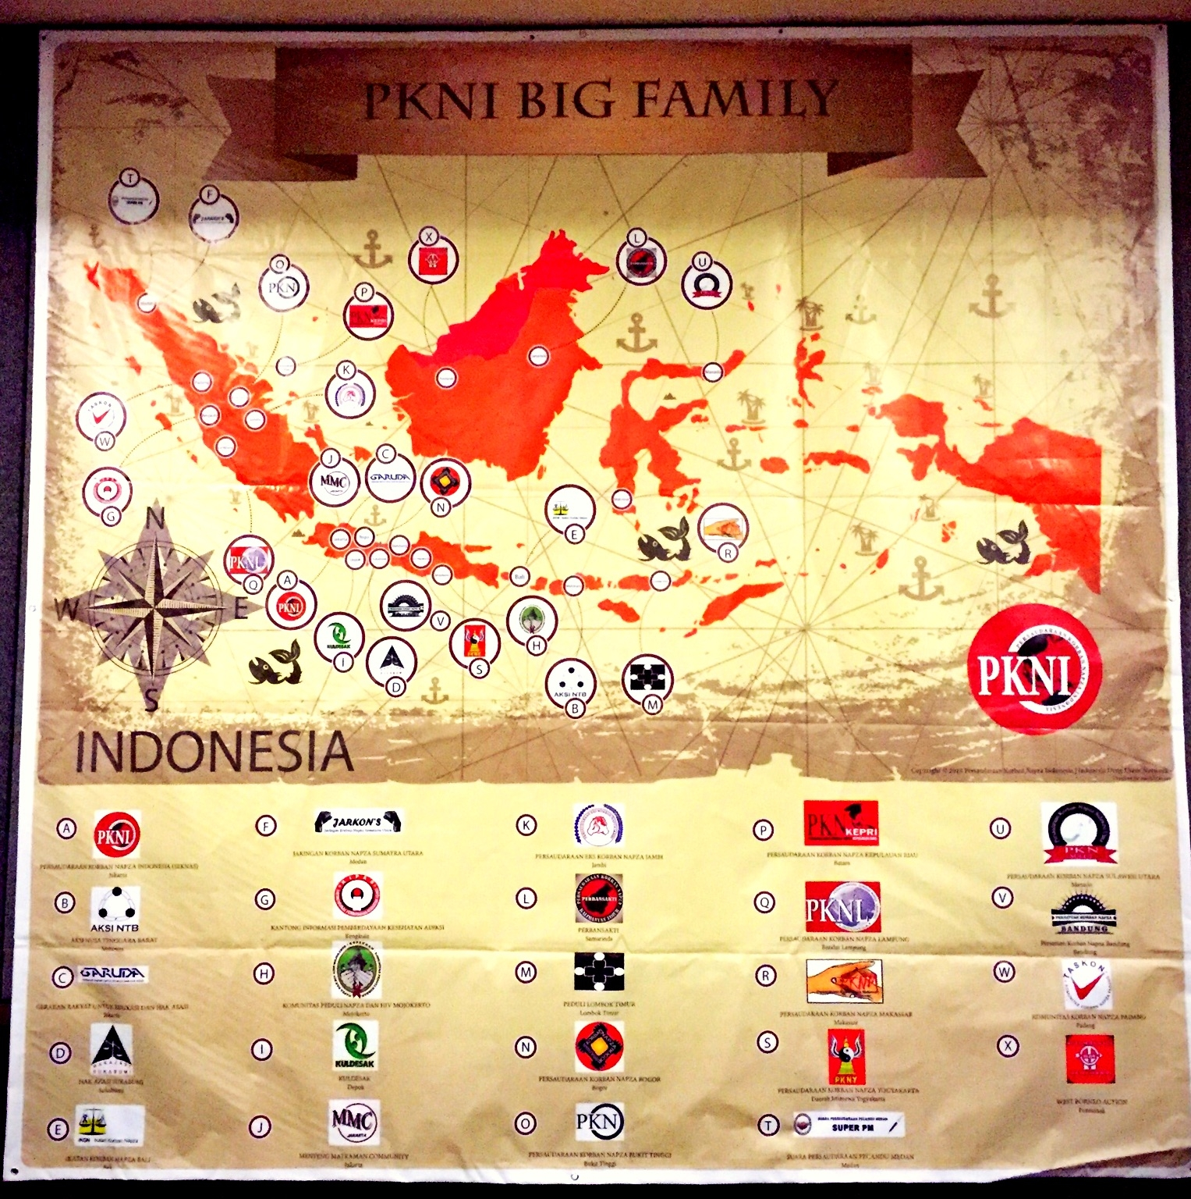
Legal Issues – Young PWID in Repressive Environment

Slide 3
Source: Harm Reduction International 2013

Slide 4
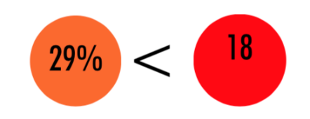
Context of Women Drug Injecting Initiation
Mean age of injecting initiation was 21.2 years, with some women injecting for the first time at 12 years of age.
96% of women were injected by someone else the first time they ever injected drugs, which is a risk factor for HIV transmission.
Source: Women Speak Out Research (PKNI-University of Oxford)

Slide 5
Indonesia’s Repressive policy environment

Slide 6
Drug Policy which criminalize the PWUD/PWID
Lack of legal acsess
Lack of health access
Overcriminalization
Human Rights Violation towards PWUD
Using drugs
Possessing drugs
Carrying drugs

Slide 7
The Barbaric ‘War on Drugs’
In 2015, President Joko Widodo declared ‘ War on Drugs’ as he stated a new status ‘Indonesia Drug Emergency’.
Compulsory Rehabilitation
Expulsion from residence
Forced Urine Test
Shoot in Place
139 people shot-dead in 2017
DEATH PENALTY

Slide 8
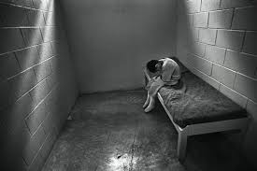
Legal Issues-Young PWID
Many young people under 18 incarcerated on drug related charges without legal assistance.
Available data is very limited
There is criminal sanction (jail and fines) for parents who don’t report their children for using drugs.
There are many cases stopped in pre-trial, because of bribery.
Social impacts: dropout from school, discrimination in health services, social exclusion, limit job opportunity.

Slide 9
What is the Indonesian Drug Users Network Doing?
Drug Users Interest Lawyer Network
paralegals
lawyers
Legal assistance
Ensure client get assessment
Ensure client get the special needs (if any)
Partnership with Harm Reduction Organization
Strategic Litigation

Slide 10
Recommendation
Move beyond a case by case legal aid approach.
Use documentation and experience of legal aid cases among young people as a tool for structural and policy change (Structural Legal Aid.
Policy change
Cases
Data
Public awareness
Legal empowerment
“ Prison is not the solution ”

